Slide 1
Mexico Toy Sales Analysis Using SQL

Slide 2
Schema
calendar
date01
sales
Sales_ID
Date
Store_ID
Product_ID
Units
product
Product_ID
Product_Name
Product_Category
Product_Cost
Product_Price
stores
Store_ID
Store_Name
Store_City
Store_Location
Store_Open_Date
inventory
Store_ID
Product_ID
Stock_On_Hand

Slide 3

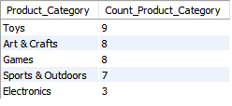
1. Which are the product categories present in the dataset?

Slide 4
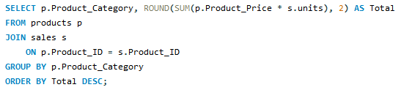
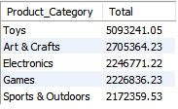
2. Which product categories drive the biggest sales?

Slide 5
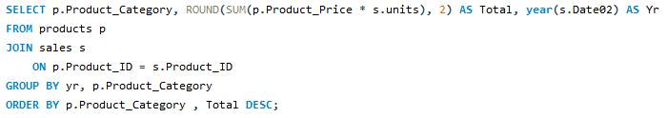
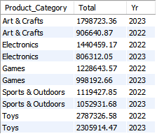
3. How much revenue did each product category make per year?

Slide 6
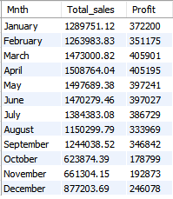
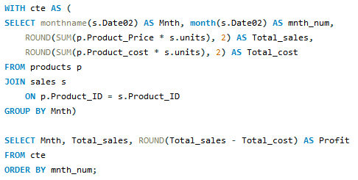
4. Determine the overall Sales and profit by month

Slide 7
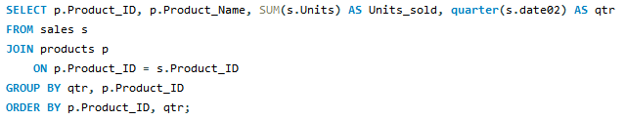
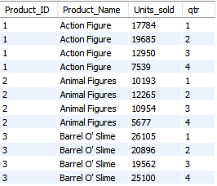
5. Determine the number of all the units of products sold by quarter

Slide 8
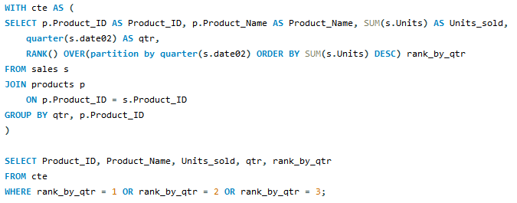
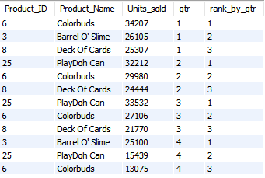
6. Determine the top 3 Products by units sold in each quarter

Slide 9
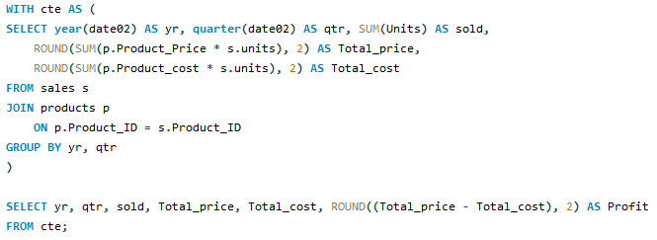
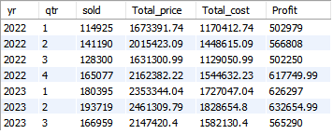
7. Determine the number of units sold and profit made in each quarter

Slide 10
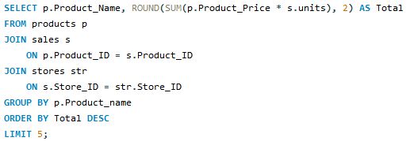
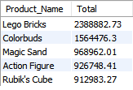
8. Sales of top 5 products

Slide 11
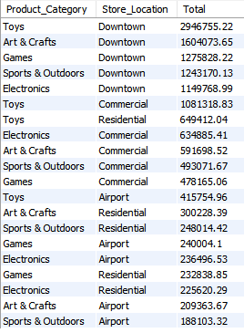
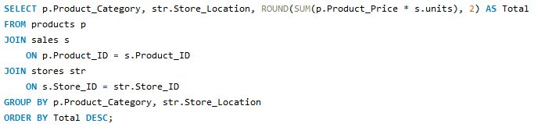
9. Which product categories drive the biggest sales across store locations?

Slide 12
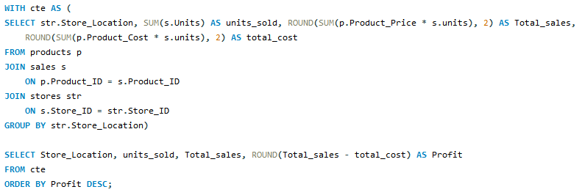

10. Which store locations has highest sales and profit?

Slide 13
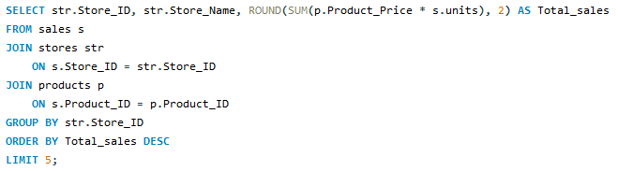
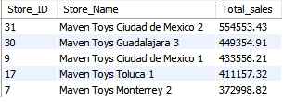
11. Determine the top 5 stores by sales

Slide 14
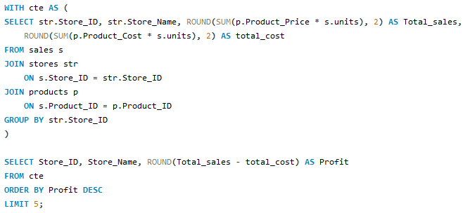
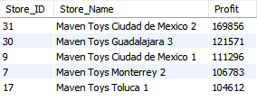
12. Determine the top 5 stores by profit

Slide 15
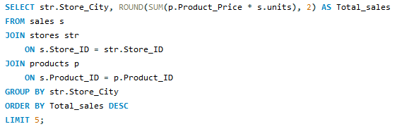
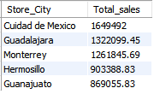
13. Determine the top 5 cities by sales

Slide 16
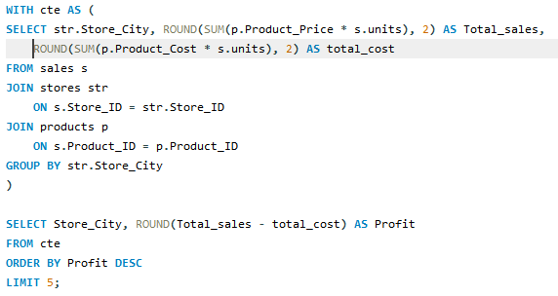
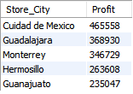
14. Determine the top 5 cities by profit

Slide 17
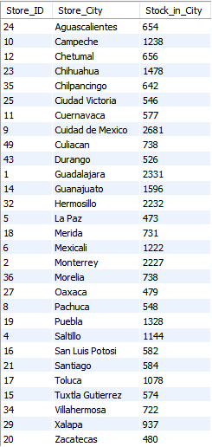
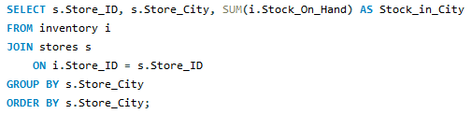
15. Determine the Stock on Hand by store city

Slide 18
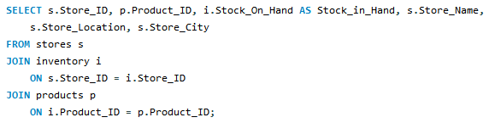
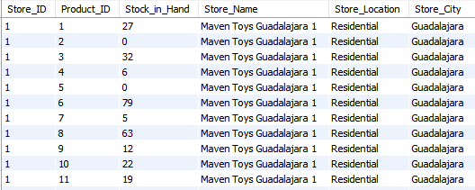
16. Products, stocks and store name

Slide 19
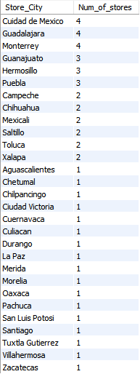

17. How many stores are there in each city?

Slide 20
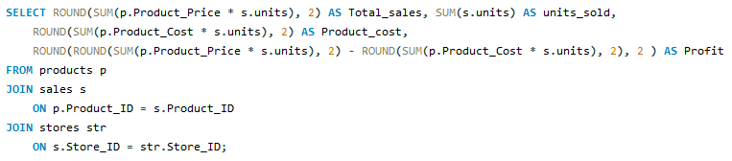

18. All time total sales, units sold, cost occurred and profit of toy stores in Mexico

